Slide 1
MediPriority AI-Driven Healthcare ECO-SYSTEM
Because we care about people

Slide 2
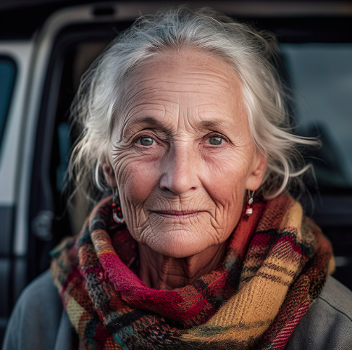
REVOLUTIONIZING MODERN CARE THROUGH INTELLIGENT PRIORITIZATION AND AUTOMATED SUPPORT
Imagine Sarah, an 75-year-old widow living alone. For months, she's been experiencing increasing joint pain, but her doctor's appointment is still a weeks away. She feels forgotten, anxious, and her health is deteriorating. This is the reality for millions of people in the developed world.

Slide 3
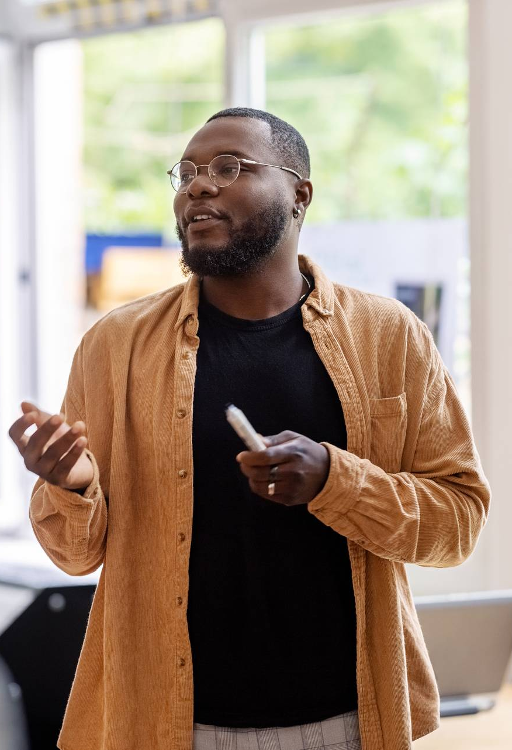
THE PROBLEM WITH CURRENT TRADITIONAL HEALTHCARE (US / Canada & other EU countries)
6-12 months for appointment: the developed healthcare time warp.
When wait times grow, health and hope shrink.
Missing the human touch: when care becomes a numbers game, healing suffers.
Delayed care, depleted economy: the hidden cost of wait times.

Slide 4
Different blocks of our ecosystem
AI Vision & Text: Smart Symptom Capture
Intelligent Inquiry Agent: Adaptive Symptom Profiling
Smart Triage: AI Urgency Analyzer
Hybrid Automated Notification: AI-Human Avatar Video
MediBot Multi-Agent: Auto-Book Meds & Tests
CalendarRx: AI Health Scheduler
Prescription Whisperer: AI Rx Decoder
AI AfterCare Companion: Smart Follow-Up

Slide 5
Looking into the deep into the ecosystem works
Mainly our ecosystem is divided into the three parts
Pre Consultation
Mid Consultation
Post Consultation

Slide 6
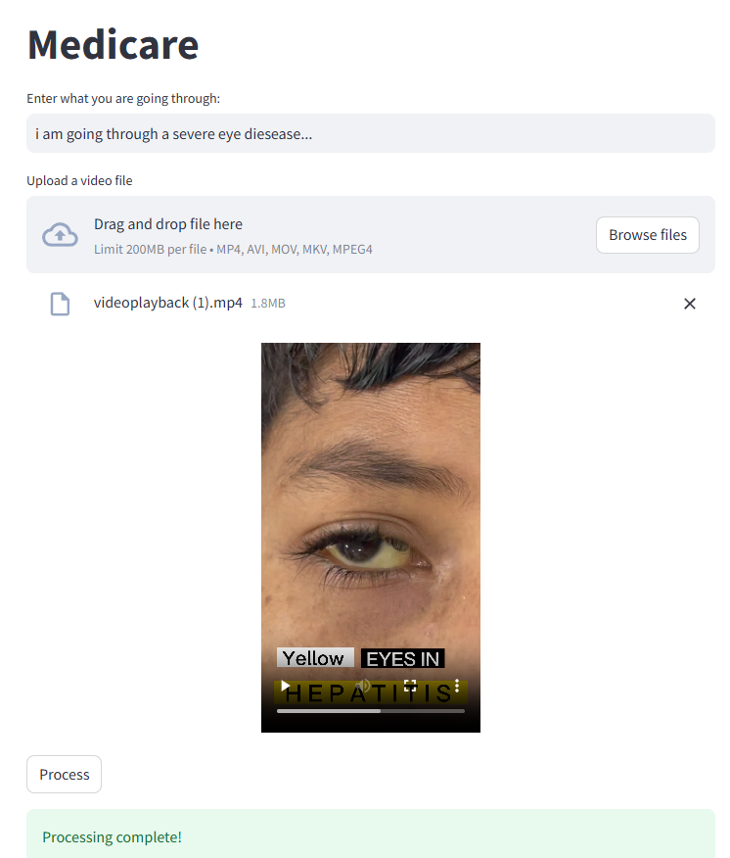
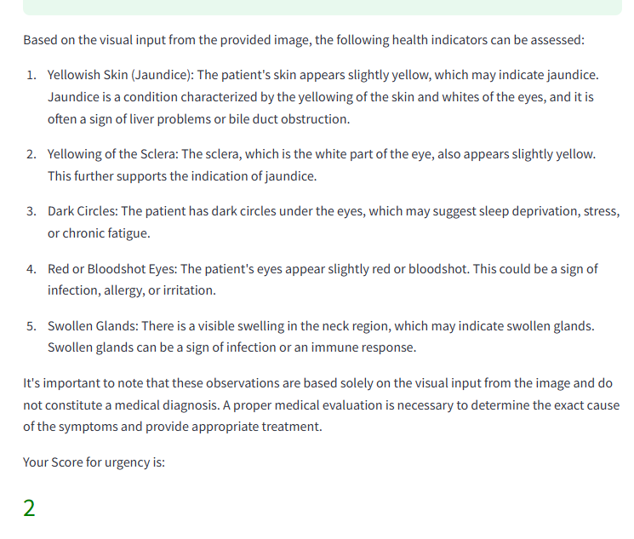

Slide 7
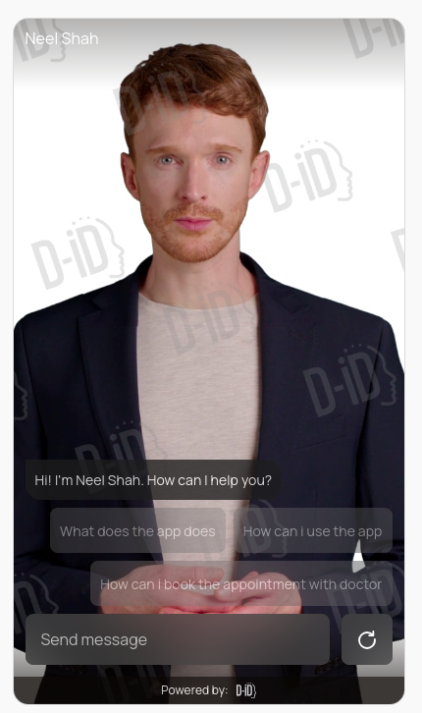
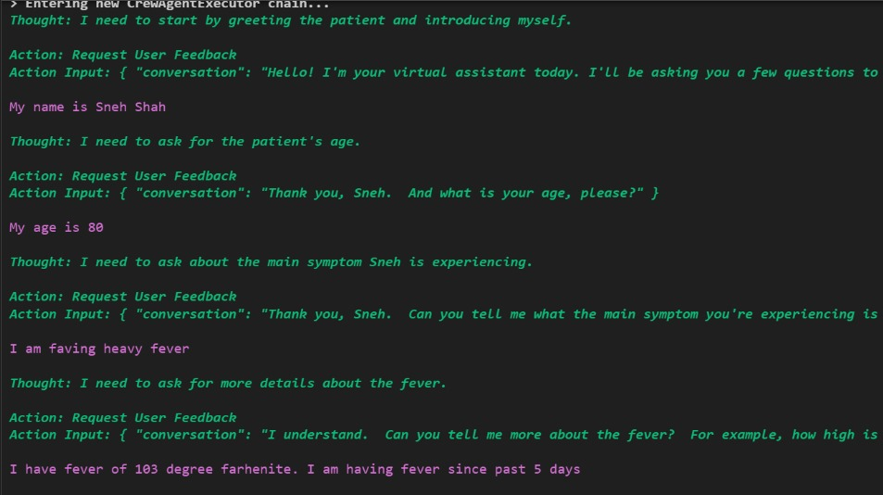

Slide 8
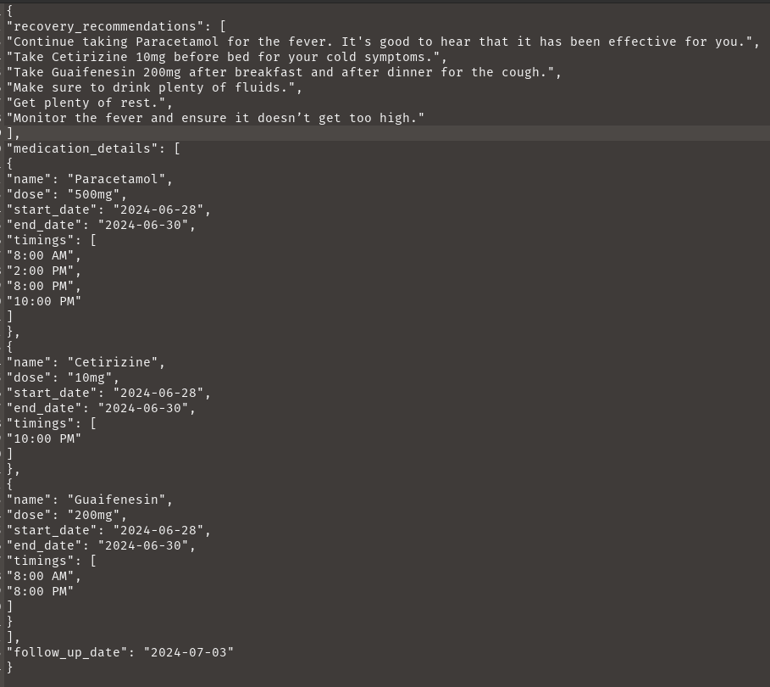
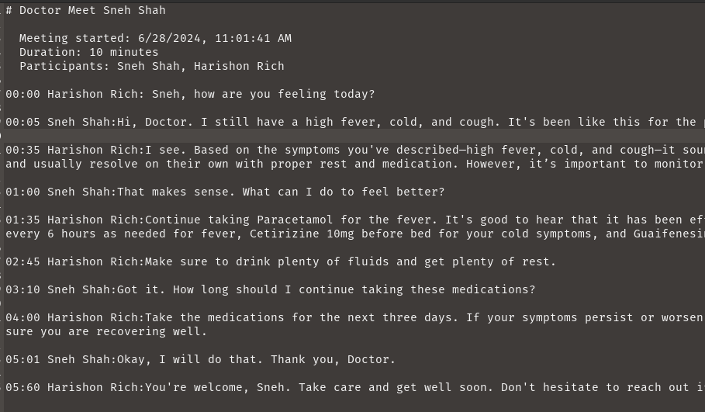
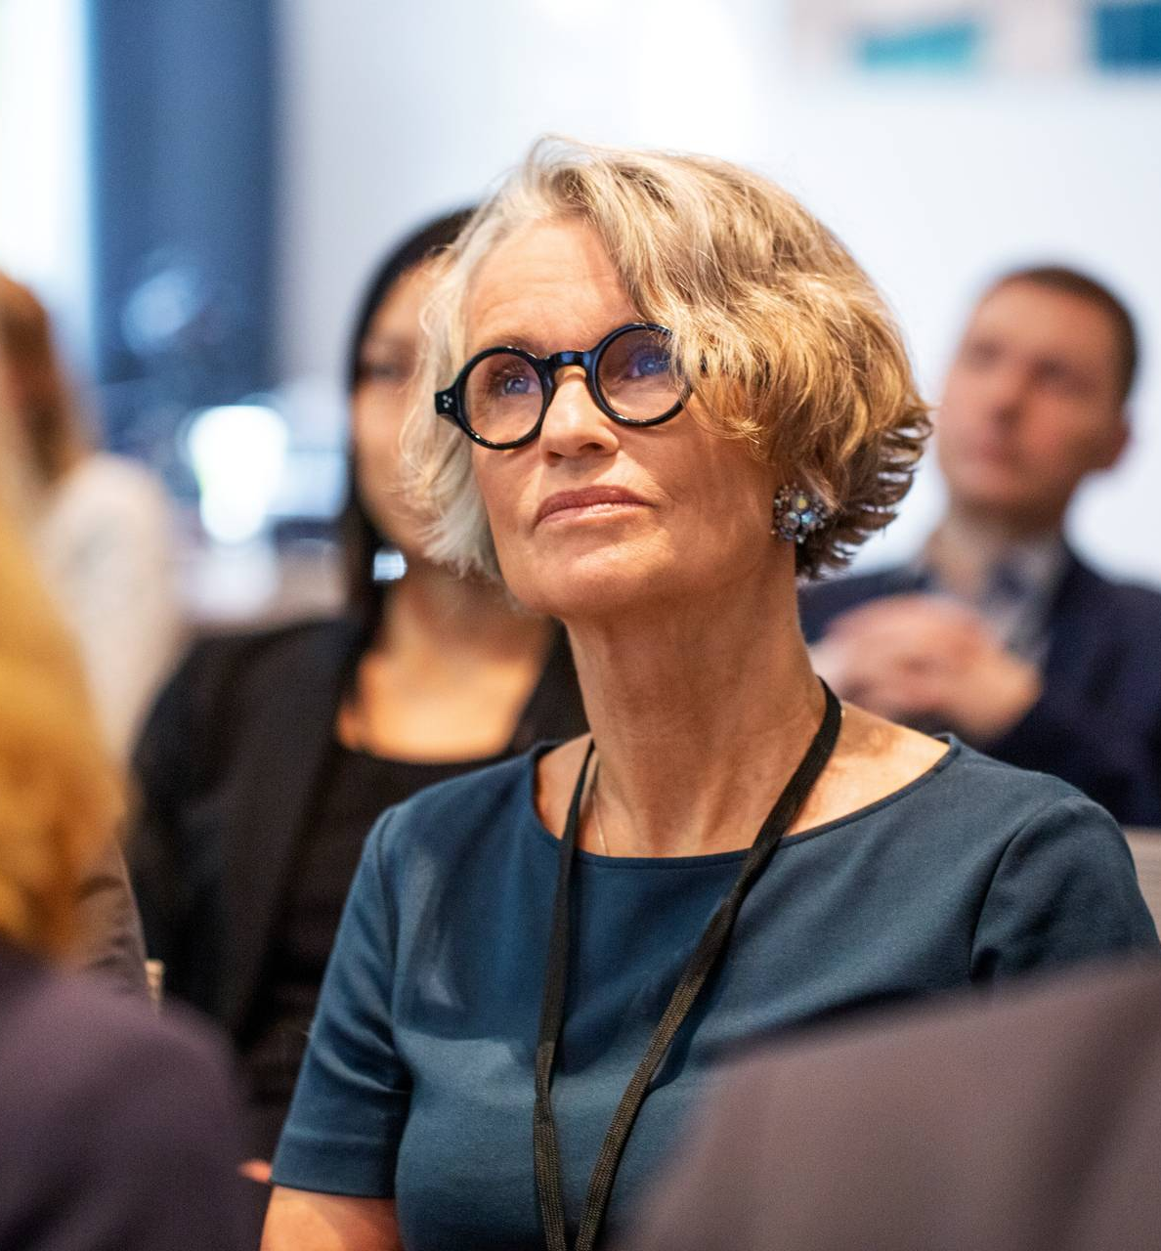

Slide 9
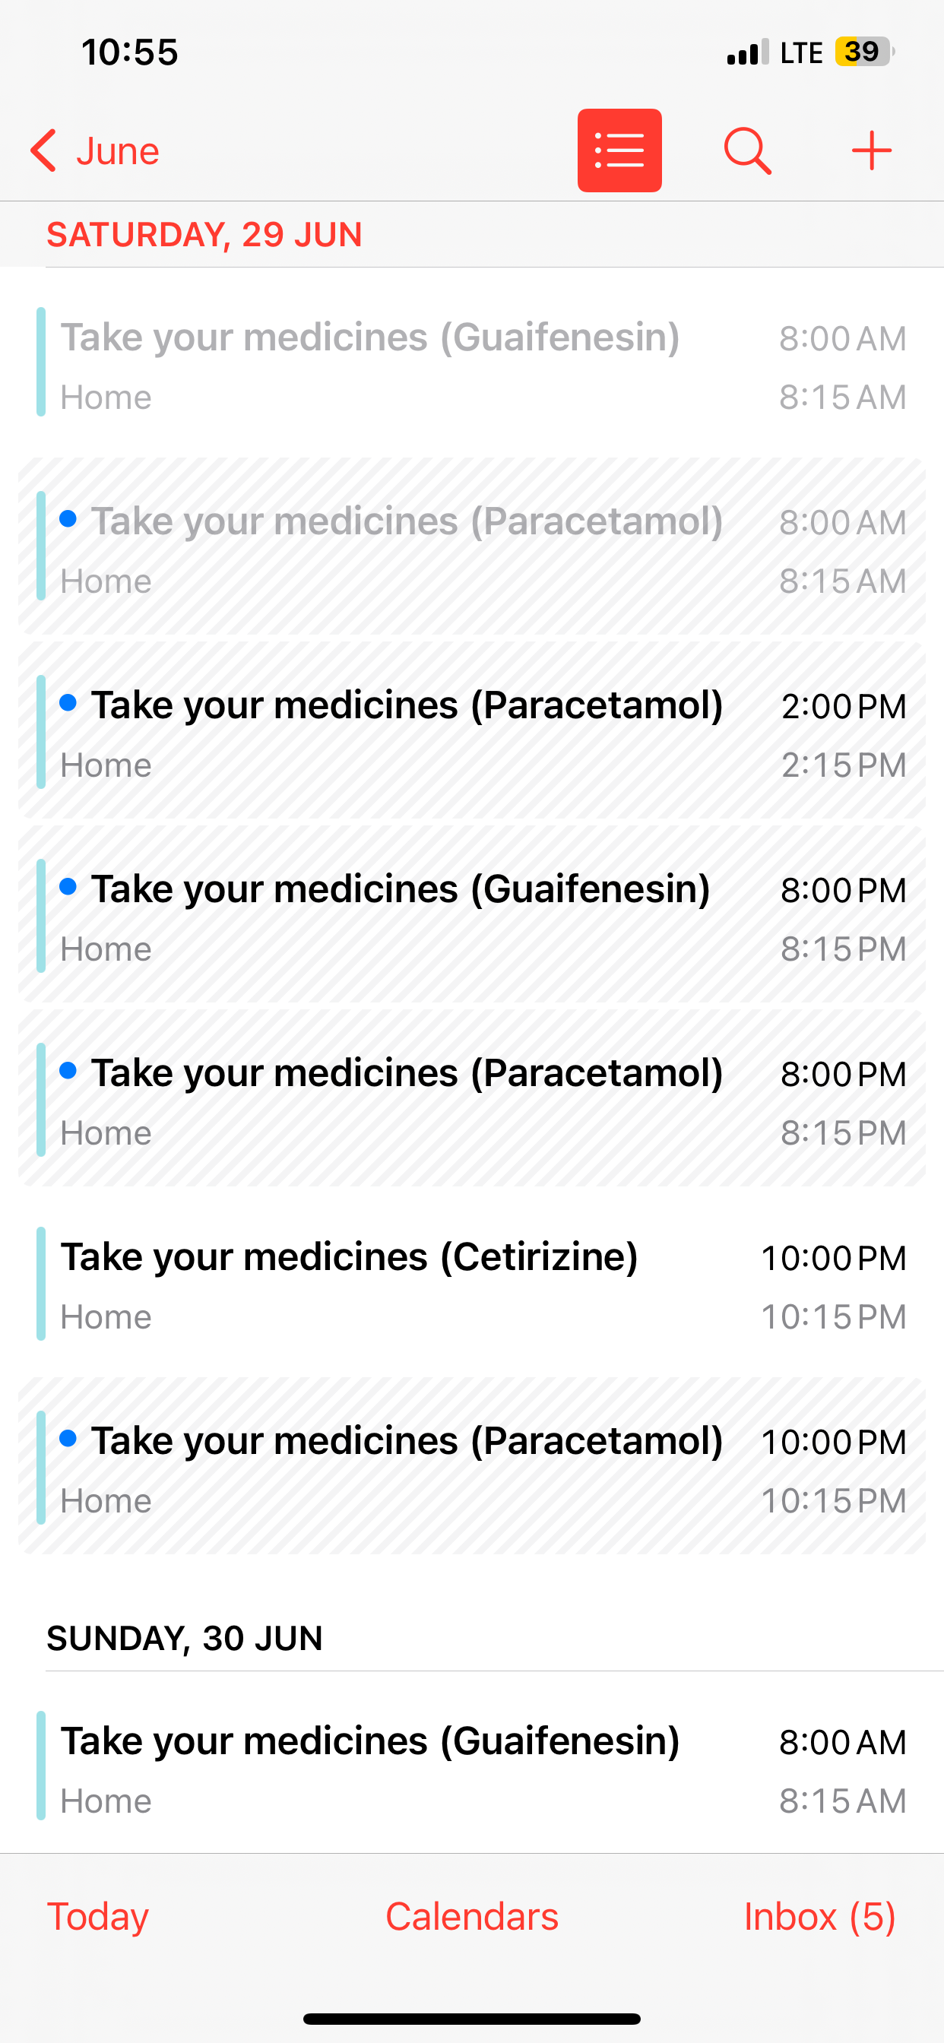
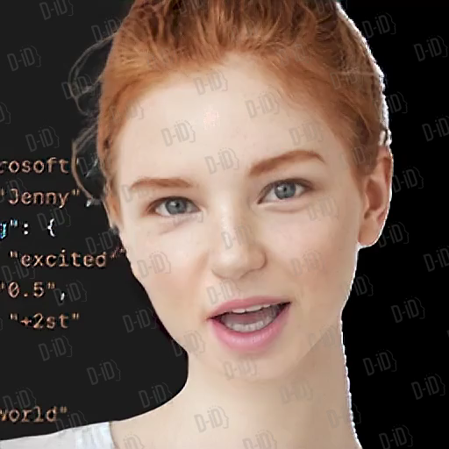

Slide 10
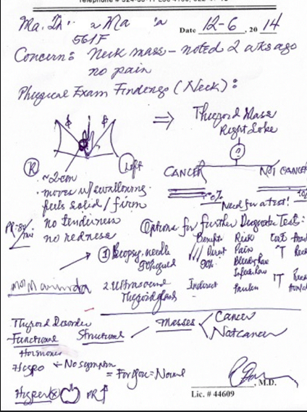
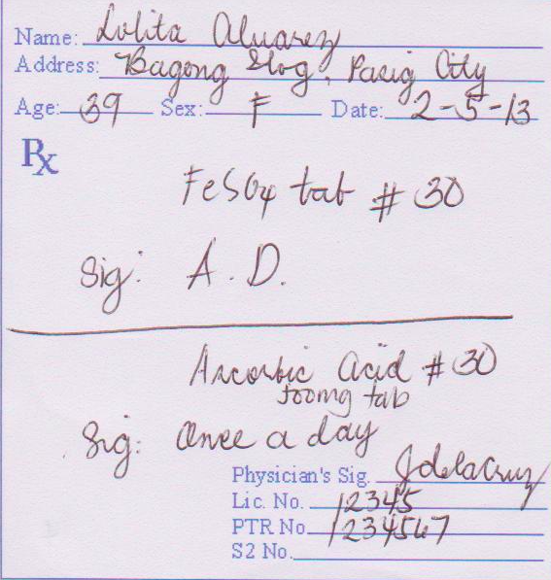
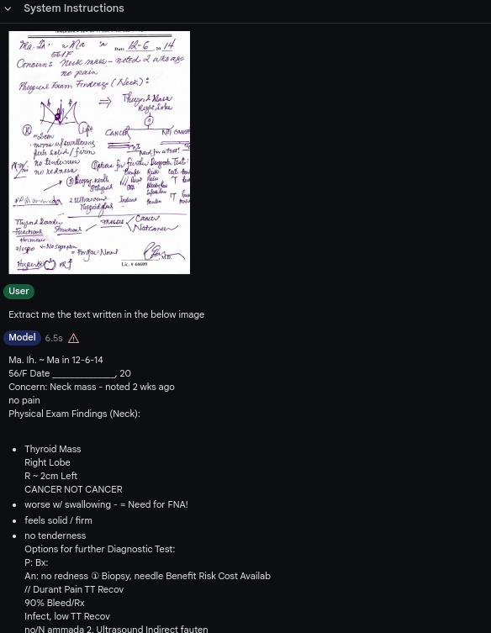

Slide 11
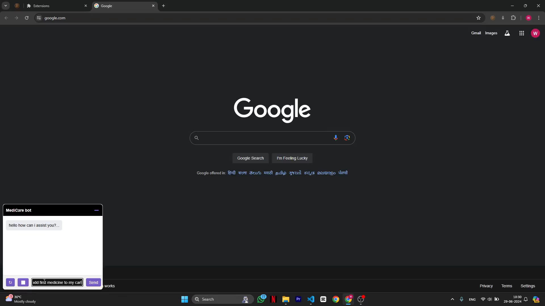

Slide 12
Future scope
Add more interpretability and fairness to all of the AI models.
Experiment with custom designed models instead of only depending on the LLMs.
Integrate all the existing models with Front-end and back-end and make entire system more scalable.
New features that we are planning
Predictive Health AI: Forecast potential health issues before symptoms appear.
Graph-Integrated Care: Personalized treatment based on genetic/similar profiles.
AI Emotional Support: Advanced chatbots for mental health assistance.

Slide 13
Thank you
Neel shah, Pankil Soni, Sneh Shah
Neeldevenshah.ai@gmail.com
Pmsoni2016@gmail.com
22aiml049@charusat.edu.in

